Slide 1
Digital Agriculture Workshop
Day 3 & 4 – Panel Discussions
Understanding of Agrix & ABERS
(The Agricultural Business Information System & Agricultural Business Entity’s Registration System)

Slide 2

CONTENTS
Overview of Agrix
(Agricultural Business Information System)
2. Overview of ABERS
(Farmers, farming association and corporation)
3. Current Status of Registration

Slide 3

Overview of Agrix
(Agricultural Business Information System)
농림사업정보시스템 개요

Slide 4

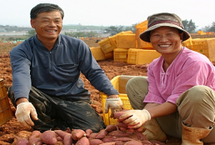
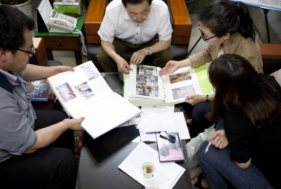


Ⅰ
1.1 Background(추진배경)
(사업별 칸막이식 신청·관리, 시스템화로 비효율 및 정보 활용 곤란)
When, where, and how to apply for the business?
Registration of and on-site inspection on farmland and farmer by the same project
Unable to manage the record of recipients
Duplicate management of and inspection on similar information
Farmer(농업인)
Local Government
(지자체)
Ministry of Agriculture
(농식품부)`
Systems
(시스템)

Slide 5





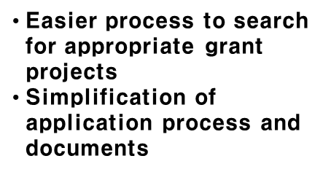
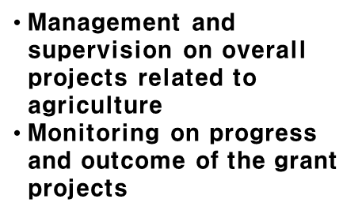
1.2. Objectives of Agrix (추진목표)
Stabilization of Agricultural Subsidies and Establishment of Smart Agriculture Policies
Objective
Farmer
Implementing Agency
(Local Governments)
Ministry of Agriculture, Food
and Rural Affairs
Direc-tion
Identify status and progress of projects including application and results.
Enhanced efficiency in administrative works
through computerization
of the project
Effective monitoring, management and analysis
on progress and issues
Farmer’s Demand
Local Government’s
MAFRA’s Demand
Back-ground
Efficiency in project management, solution to fraud ,overlapped payment
and unequal support, and simplification of repeated and unnecessary works
농림사업관리의 효율화, 예산의 부정·중복 수급 및 편중지원 해결, 반복되는 불필요한 업무의 간소화

Slide 6


1.3 Reporting on the Progress (경과)
4 types of citizen service
  14,200 Users
  More than 3,000 hits daily
91 types of integrated support Project
13TB 데이터
13 TB of data
14 types of common and other works
10 types of approved statistics
28 types of work related to enterprises
  Operation of System that processes
  147 types of work
Stable Integrated Operation(2018~ )
Enhanced transparency
and work efficiency
Operation of System by ABER(2013~2017)
Operation of System by
Project Unit(2015~2012)
Establishment of Integrated Management System(105 types)
Establishment of project support
system in AgriX (40 types)

Slide 7





1-4. Chart of Agrix in Organizations and Projects
Payment Programs using ABERS Database(115 units)
Direct payment for
Environment-friendly agriculture
Compensation for Damaged District
Organic Fertilizer Aid
Animal and Plant Quarantine Agency
Direct payment for Environment-friendly livestock
Direct payment for landscape conservation
Direct Payment for Rice Cultivation
밭농업직불제
Direct Payment for Upland Farming
Korea Agency of Education, Promotion, Information Service in Food, Agriculture, Forestry and Fisheries
Report of ginseng cultivation
Expansion of forage production
Post management of tax exemption oil
Direct payment for
early retirement
Direct payment for less
favored area
Korea Institute for Animal Products Quality Evaluation
Agricultural business entity’s DB
농기계임대사업
농기계임대사업
농기계임대사업
JAEUNG, CHOI(name)
YUNI,LEE
JAEKYU, CHO
Address, Member
of household)
Address, Member
of household)
Address, Member
of household)
(Ministry of Health and Welfare
PNUcode, area, product
(5-1, 3ha, onion)
PNUcode, area, product
(25번지, 0.5ha, millet)
PNU code, area, product
(5번지, 2ha, rice)
Residential Information/land register
Ministry of the Interior and Safety, Ministry of Land, Infrastructure and Transport
record of payment
(Fixed payment for rice, landscape conservation)
record of payment
(tax-free oil, landscape conservation)
record of payment
(Fixed payment for rice, landscape conservation)
External
Agencies
Off-farm Income Information
National Tax Service
National Agricultural
Cooperative Federation
(Report on ginseng/rental service of agricultural machinery/tax-free oil
Korea Rural
Community Corporation
(farmland banking information)
Ministry of Health
and Welfare
(pension)
Ministry of Health
and Welfare
(health insurance)
Disaster insurance company for agriculture and livestock

Slide 8
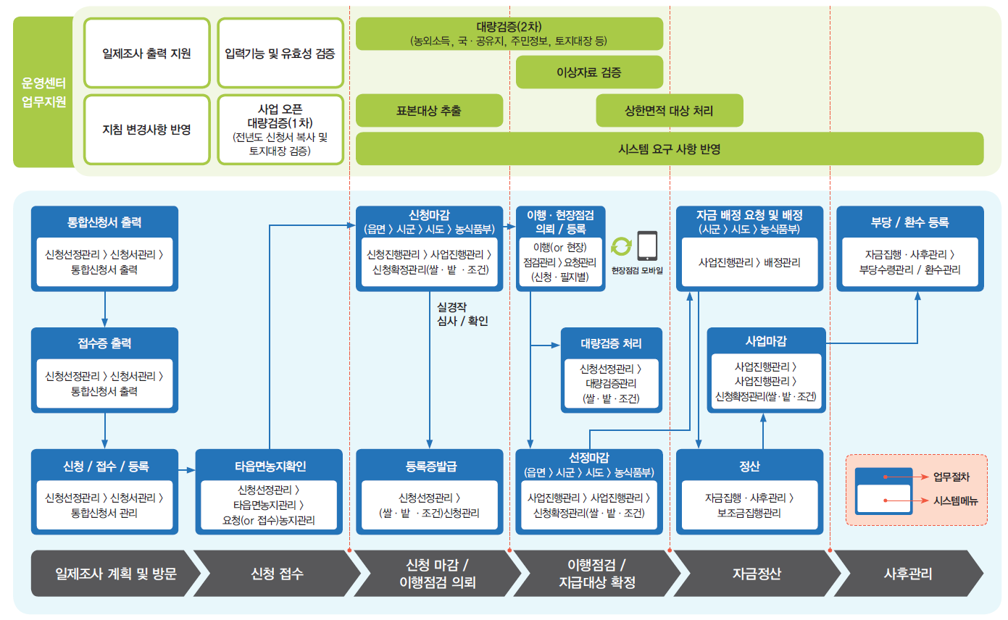
1-5. Administrative Work Support by Utilizing AgriX
(아그릭스를 활용한 보조사업 지원)
5
■ Provision of services including project application, selection and follow-up management
Inspection plan and visits → Application → Application closed/Request for monitoring of implementation → Monitoring/Confirmation of targets for payment → Calculation of the funds → Follow-up management

Slide 9
2. Overview of ABERS
농업경영체 등록제도 일반

Slide 10
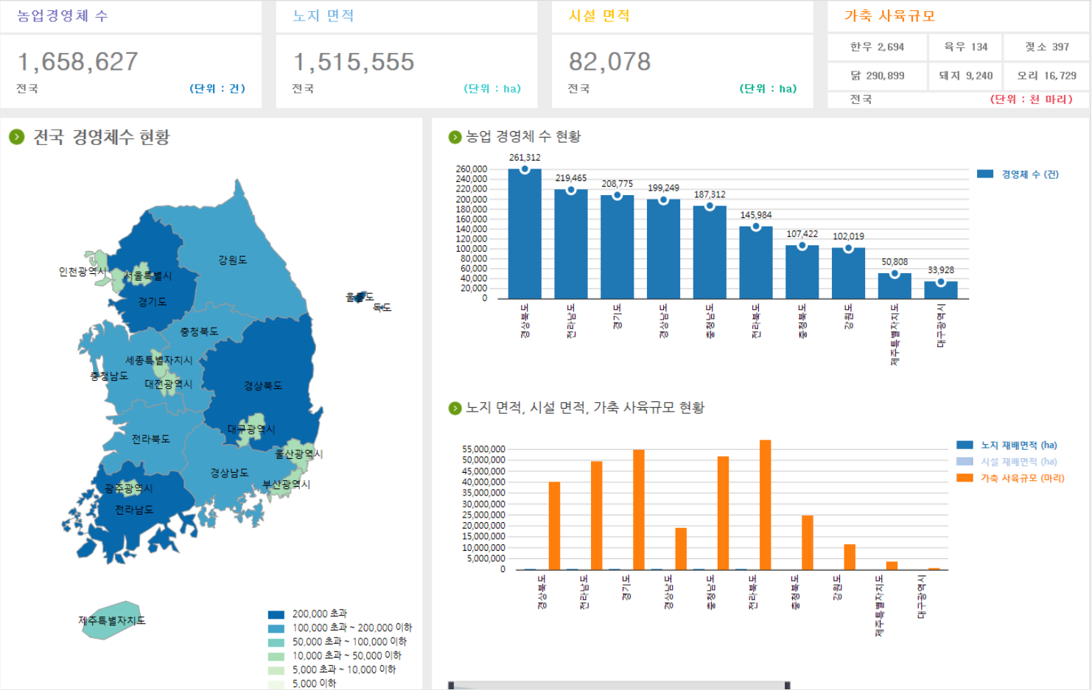
2-1. Summary of Registration in 2018 (등록현황)
6
3
Area of Protected Farming(ha)
2
Area of Outdoor Farming (ha)
1
Total Number of ABEs
4
Livestock (1,000 heads)

Slide 11
2-2. Legal Basis (법적근거)
7
Act on Fostering and Supporting Agricultural and Fisheries Business Entities
(농어업경영체 육성 및 지원에 관한 법률)
Purpose (목적)
To collect basic business information of each agricultural business entity (ABEs: farmers, farming association and corporation) to utilize data in providing subsidies and establishment of policies.
(경영체인 농업인과 법인의 경영정보를 수집하여 보조금지원, 정책수립에 활용)
Article 4 (Registration of Information)
An agricultural or fisheries business entity that intends to obtain financial support shall register the each business information. (농업농촌에 관련된 보조금을 지원받으려는 경영체는 경영정보를 등록하여야 한다.)

Slide 12

2-3. Reporting on the Progress (경과)
8
Start of
pilot project
(시범사업개시)
Introduction
of system
(시스템 도입)
Updates of
Information
(현행화 추진)
Enactment Of law
(법제정)
Registration at Once
(일제등록)
2007
2009
2013
2014
2015~

Slide 13
2-4. Characteristics of ABERs’ Information
(등록정보의 특성)
9
ABERs
Classification
Agricultural Statistics
Voluntary Registration
(자발적 등록)
Methodology
(조사방법)
Sample Survey
(표본조사)
NAQS
(국립농산물품질관리원)
Collection Agency
(조사주체)
Statistics Korea
(통계청)
Information on Individual Entity
(각 개체별 정보)
Value
(수치의 형태)
Estimated Value
(추정값)
All year around
(연중)
Base Time
(시점)
Upon time of survey
(조사시점)
By each ABE
(개별 경영체 단위)
Supply Range
(제공범위)
By City or Province
(시도/시군 단위)

Slide 14
2-5. Chart of Organizations and Projects Linked with
ABERS Database(농업경영체DB와 연계한 보조사업 및 기관별 연계도)
Payment Programs using ABERS Database(115 units)
Direct payment for
Environment-friendly agriculture
Compensation for Damaged District
Organic Fertilizer Aid
Animal and Plant Quarantine Agency
Direct payment for Environment-friendly livestock
Direct payment for landscape conservation
Direct Payment for Rice Cultivation
밭농업직불제
Direct Payment for Upland Farming
Korea Agency of Education, Promotion, Information Service in Food, Agriculture, Forestry and Fisheries
Report of ginseng cultivation
Expansion of forage production
Post management of tax exemption oil
Direct payment for
early retirement
Direct payment for less
favored area
Korea Institute for Animal Products Quality Evaluation
Agricultural business entity’s DB
농기계임대사업
농기계임대사업
농기계임대사업
JAEUNG, CHOI(name)
YUNI,LEE
JAEKYU, CHO
Address, Member
of household)
Address, Member
of household)
Address, Member
of household)
(Ministry of Health and Welfare
PNUcode, area, product
(5-1, 3ha, onion)
PNUcode, area, product
(25번지, 0.5ha, millet)
PNU code, area, product
(5번지, 2ha, rice)
Residential Information/land register
Ministry of the Interior and Safety, Ministry of Land, Infrastructure and Transport
record of payment
(Fixed payment for rice, landscape conservation)
record of payment
(tax-free oil, landscape conservation)
record of payment
(Fixed payment for rice, landscape conservation)
External
Agencies
Off-farm Income Information
National Tax Service
National Agricultural
Cooperative Federation
(Report on ginseng/rental service of agricultural machinery/tax-free oil
Korea Rural
Community Corporation
(farmland banking information)
Ministry of Health
and Welfare
(pension)
Ministry of Health
and Welfare
(health insurance)
Disaster insurance company for agriculture and livestock

Slide 15





2-6. Structure of Organizations(조직체계)
11
The Ministry of Agriculture, Food and Rural Affairs
MAFRA
(농식품부)
Establishment of Laws and Policies
법과 제도 수립
National Agriculture Products Quality Management Service
NAQS
(농관원)
Registration and Update of ABEs’ information
경영체 등록, 정보 현행화
Korea Agency of Education, Promotion and Information Service in Food, Agriculture, Forestry and Fisheries
EPIS
(농정원)
Analysis and Management of Data
정보분석, 데이터관리

Slide 16
3. Current Status of Registration
농업경영체 등록정보 현황

Slide 17
3-1. Information of Registration(등록정보)
12
전/겸업(Full-time/Part-time)
노지/시설
(Outdoor/Protected)
연령(Age)
지목(Paddy/Dry)
연락처(Contact Information)
품목(Products)
면적(Square Measure)
거주지
(Address)
자경/임대
(Own/Rent)
지번(Parcel Number Unit, PNU)
1. 농업인(Farmer)
2. 농지(Farmland)
영농기간
(Farming period)
Information of ABERS
3. 가축 및 곤충
(Livestock and Insects)
4. 기타(Others)
사육두수
(Breeding Heads)
축종/곤충(Species)
사육시설
(Breeding Facilities)

Slide 18
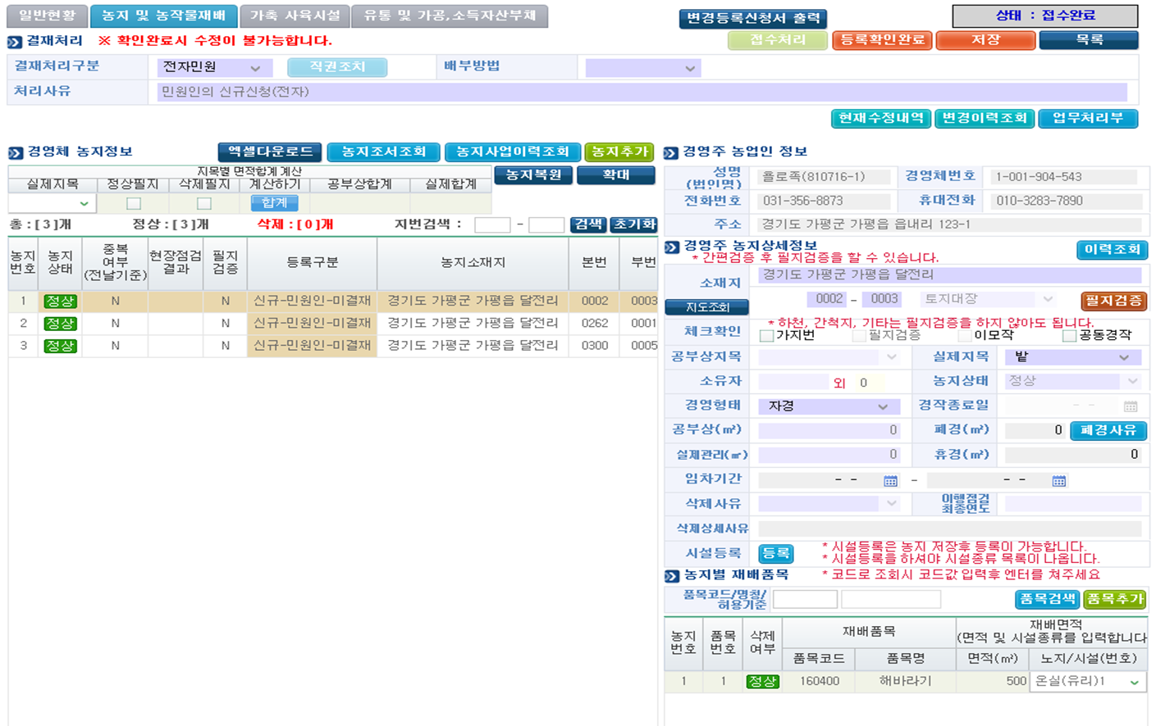
3-2 Illustration of the System (필지관리 예시)
13
Farmer(농업인 정보)
Name, address, etc.
2
1
Information on Farmland(농지정보)
Details of Land(농지세부)
PNU, dry field, owner, area, etc.
3
Product (재배품목, 면적)
Type of crops, area (㎡)
4

Slide 19
Thank you for
your Attention
감사합니다
Ministry of Agriculture, Food and Rural Affairs

